Slide 1

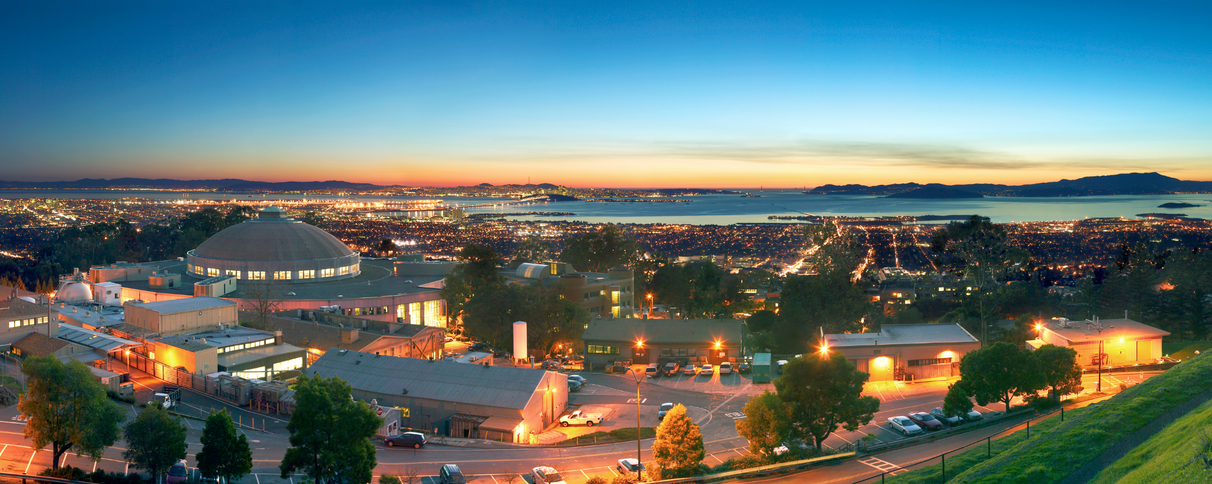
\
Trent Northen
Berkeley Lab, JGI, JBEI
Pathway Tools Workshop, SRI, Feb 14th 2018
Metabolomic investigations of microbial interactions and functional annotations

Slide 2
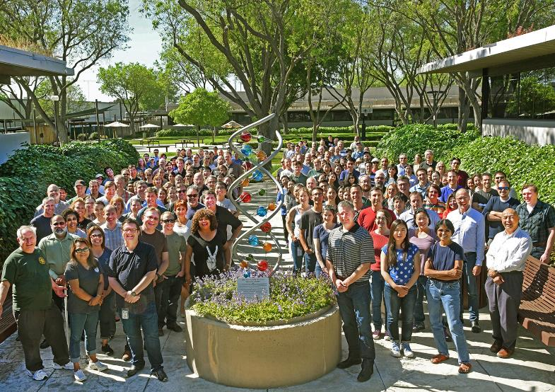
DOE Joint Genome Institute
Metabolomics is now freely available through JGI user programs

Slide 3
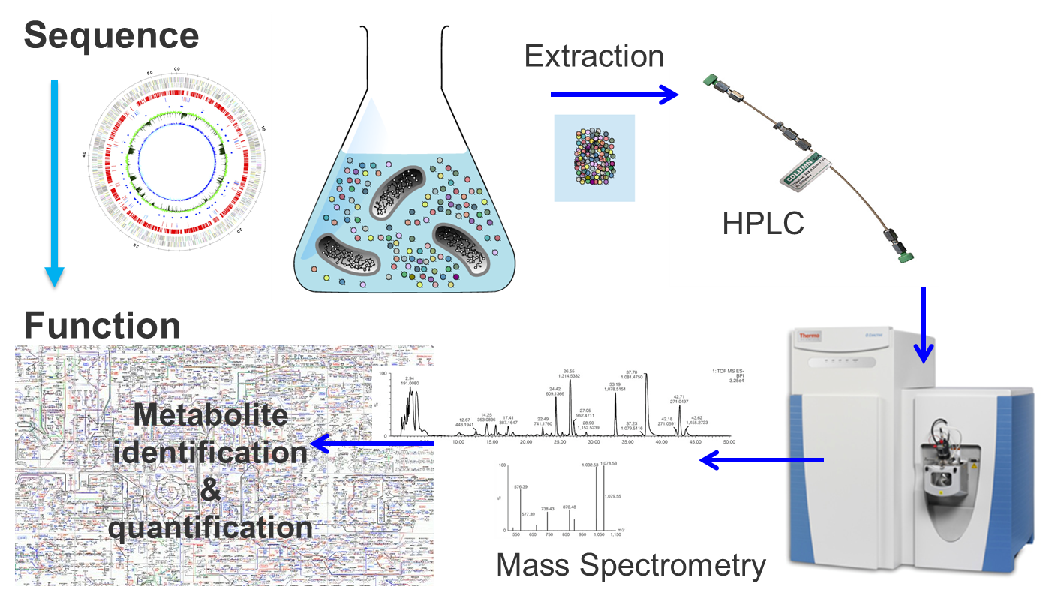
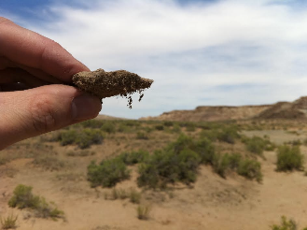
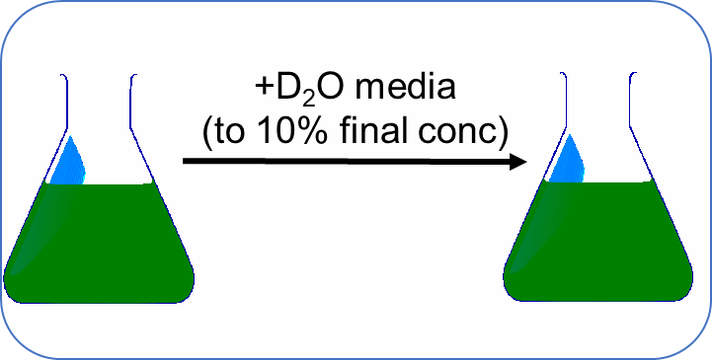
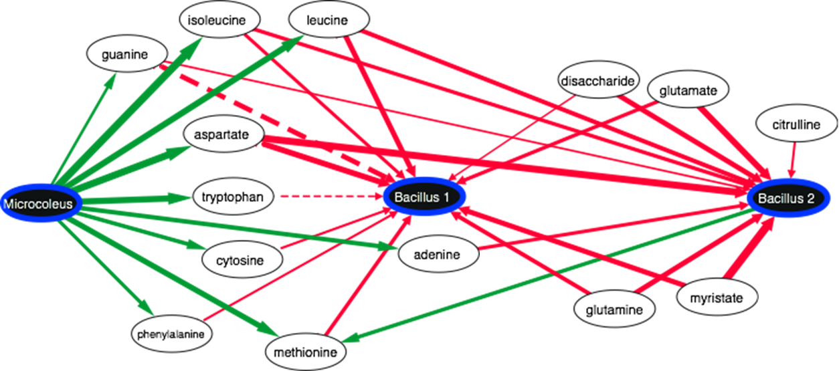
Outline
Introduce metabolomics approaches
Introduction to biocrusts
Flux Balance Analysis modeling of cyanobacterial metabolism
Stable isotope probing to identify unexpected metabolic processes
Extension to cyanosphere microbiomes

Slide 4

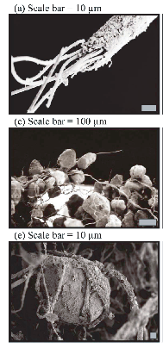
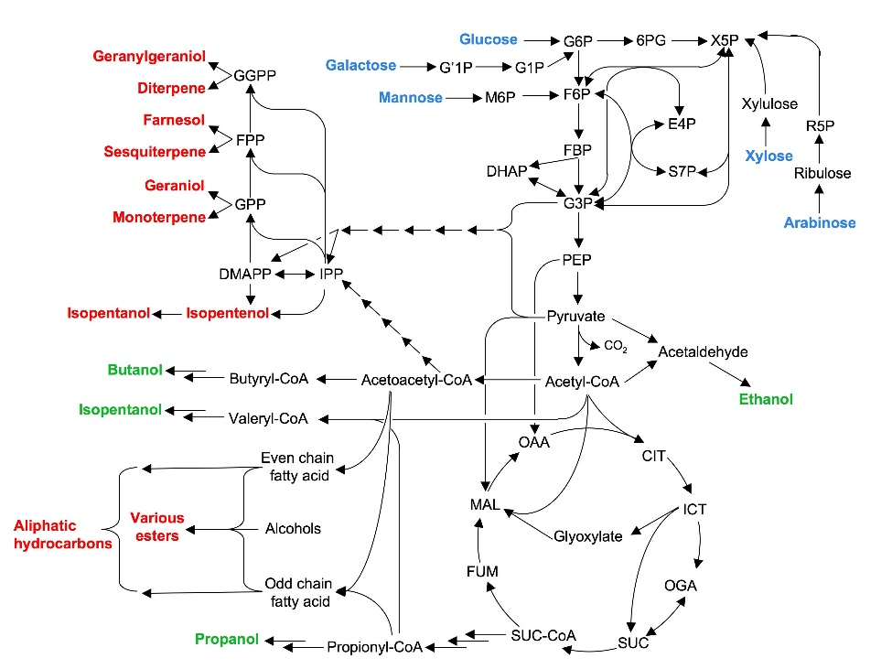
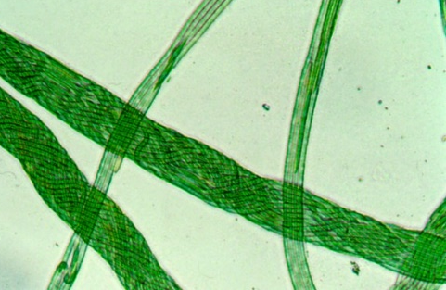
Many aspects to microbial metabolism
Model Microbiome: Microcoleus sp. Filamentous Cyanobacteria that fix atmospheric carbon dioxide and bind the soil forming these biocrusts
Cellulose
Extracellular activities
Hemicellulose
EPS production
Xylose
Arabinose
Glucose
Release
Uptake
Metabolic Network

Slide 5
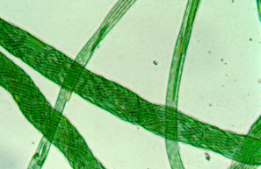
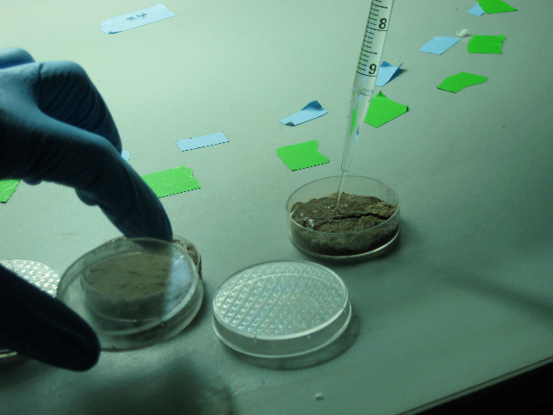
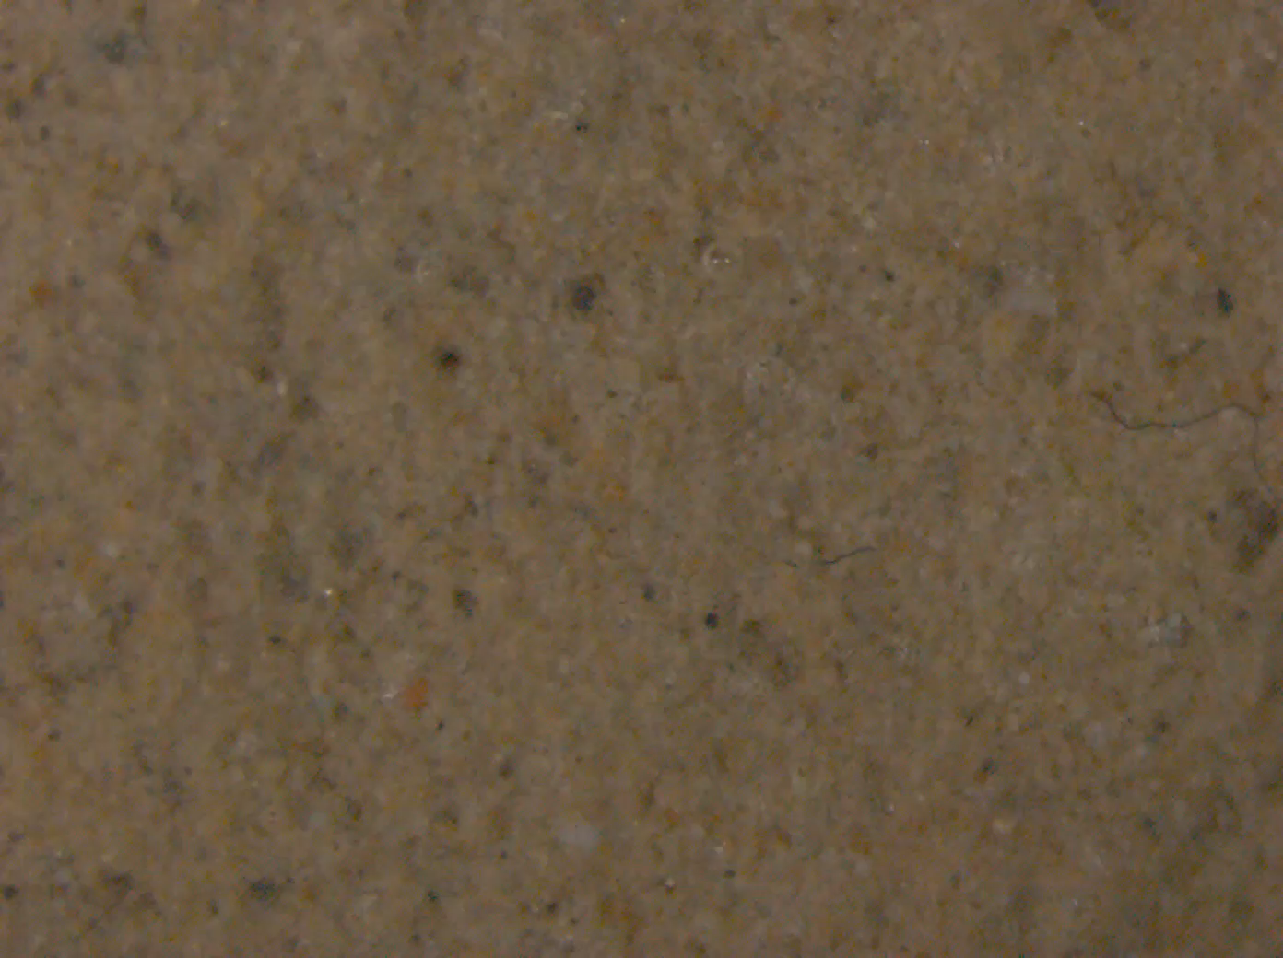
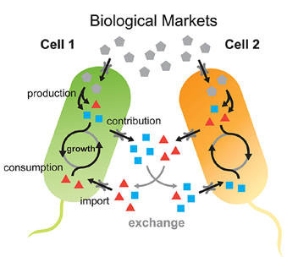
We want to understand the adaptations, interactions, and tipping points for Microcoleus vaginatus
Laboratory Wetting Event

Slide 6
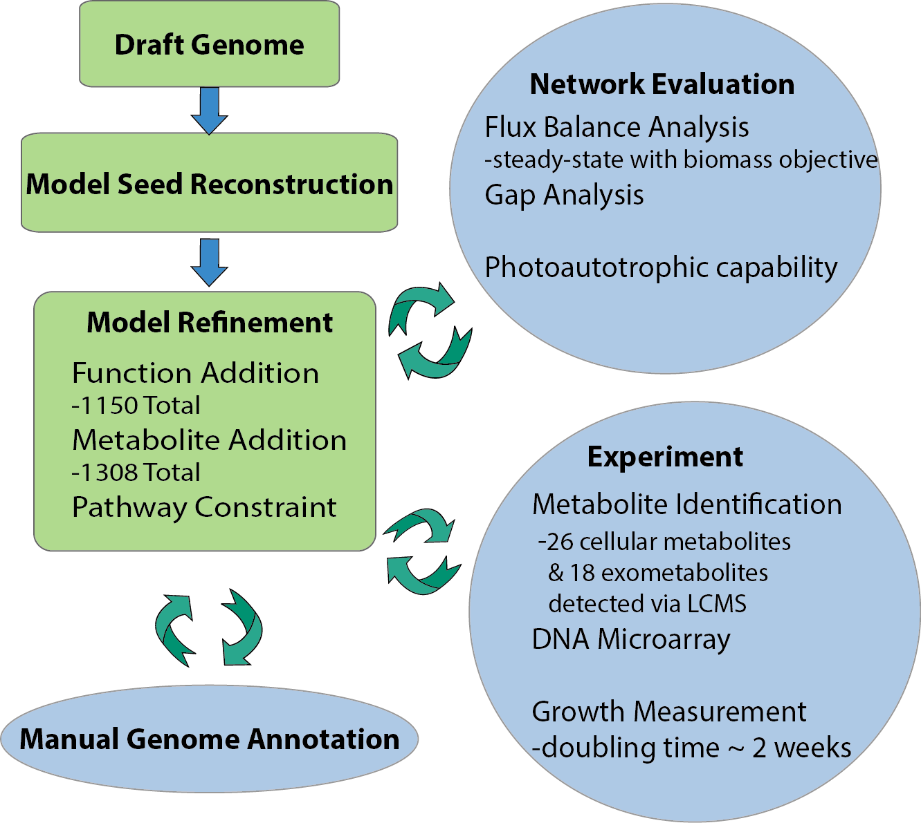
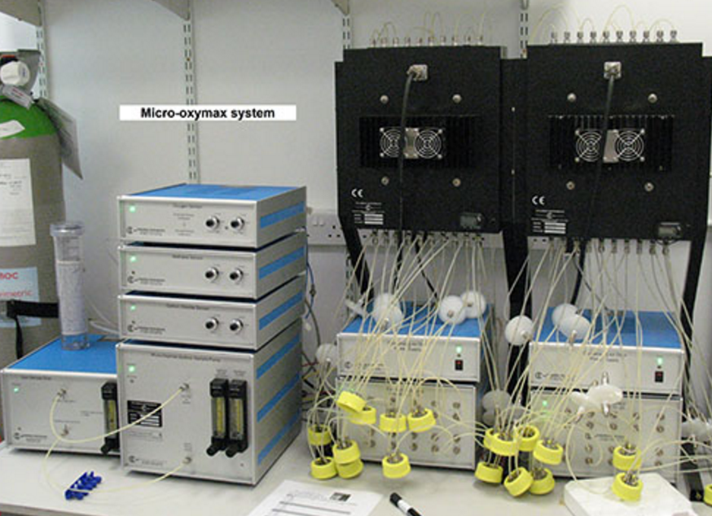
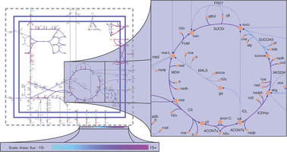
Sequenced and annotated the genome and built a flux balance model to test our understanding of Microcoleus
Predict biomass accumulation, respiration and photosynthesis rates
Use respirometer to test predictions

Slide 7
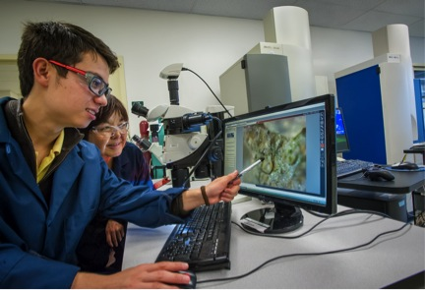
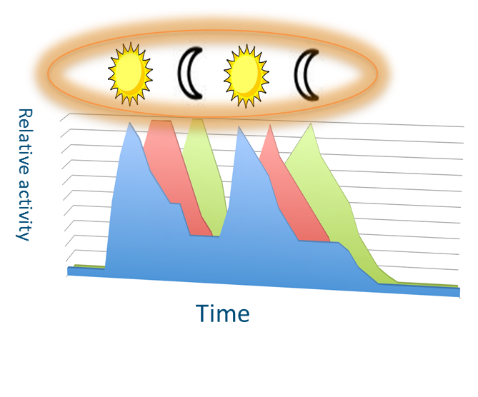
We must be missing dominant fluxes
Respiration
Photosynthesis
Nick Jose
Model prediction
Model prediction
Jose et al, In review
Nils Klitgord and Nick Jose

Slide 8
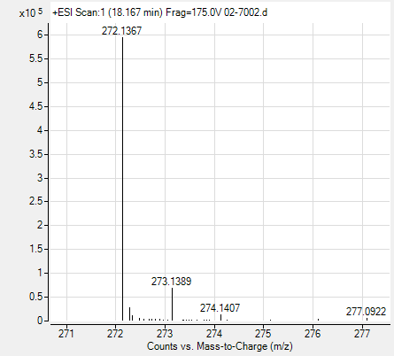
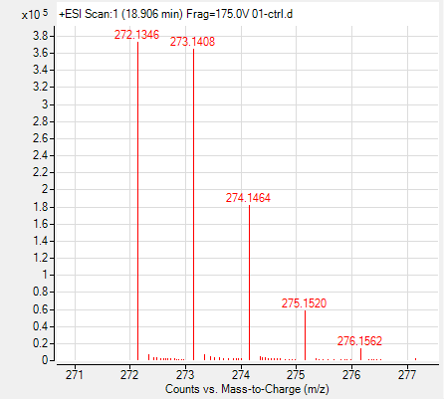
Stabile isotope probing to globally measure metabolic flux
Experimental design to measure global metabolic flux
Control
10% D₂O
+D₂O media
(to 10% final conc)
Baran et al, ACS Chem. Bio. 2017

Slide 9
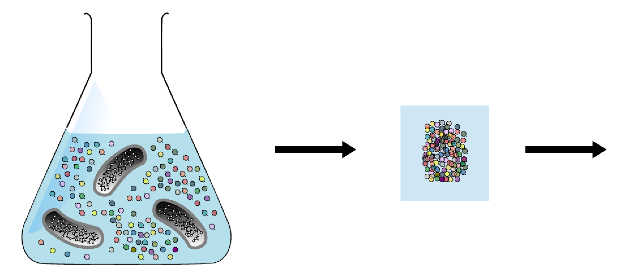
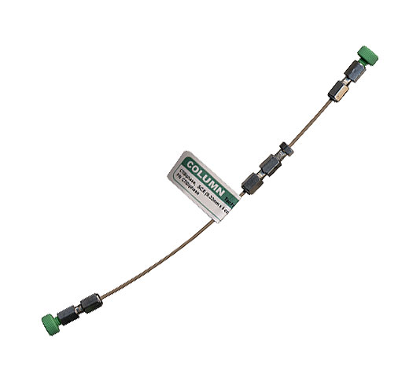
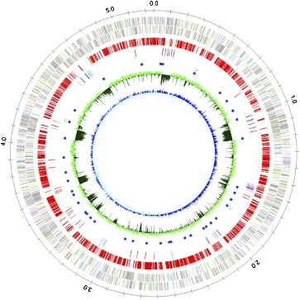
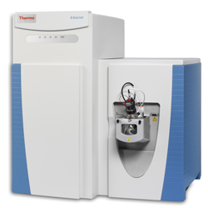
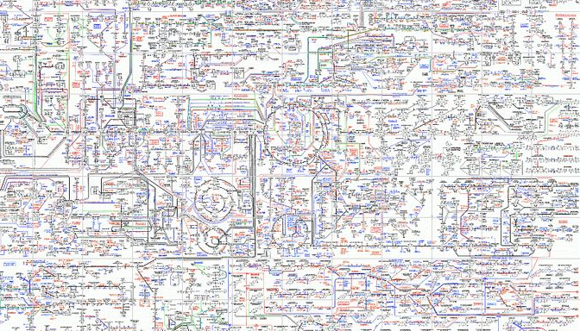
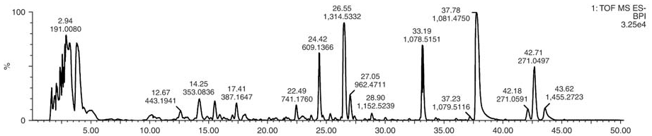
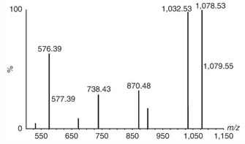
LC-MS/MS metabolomics
Sequence
Extraction
HPLC
Function
Metabolite identification
&
quantification
LC/MS
Mass Spectrometry
9

Slide 10
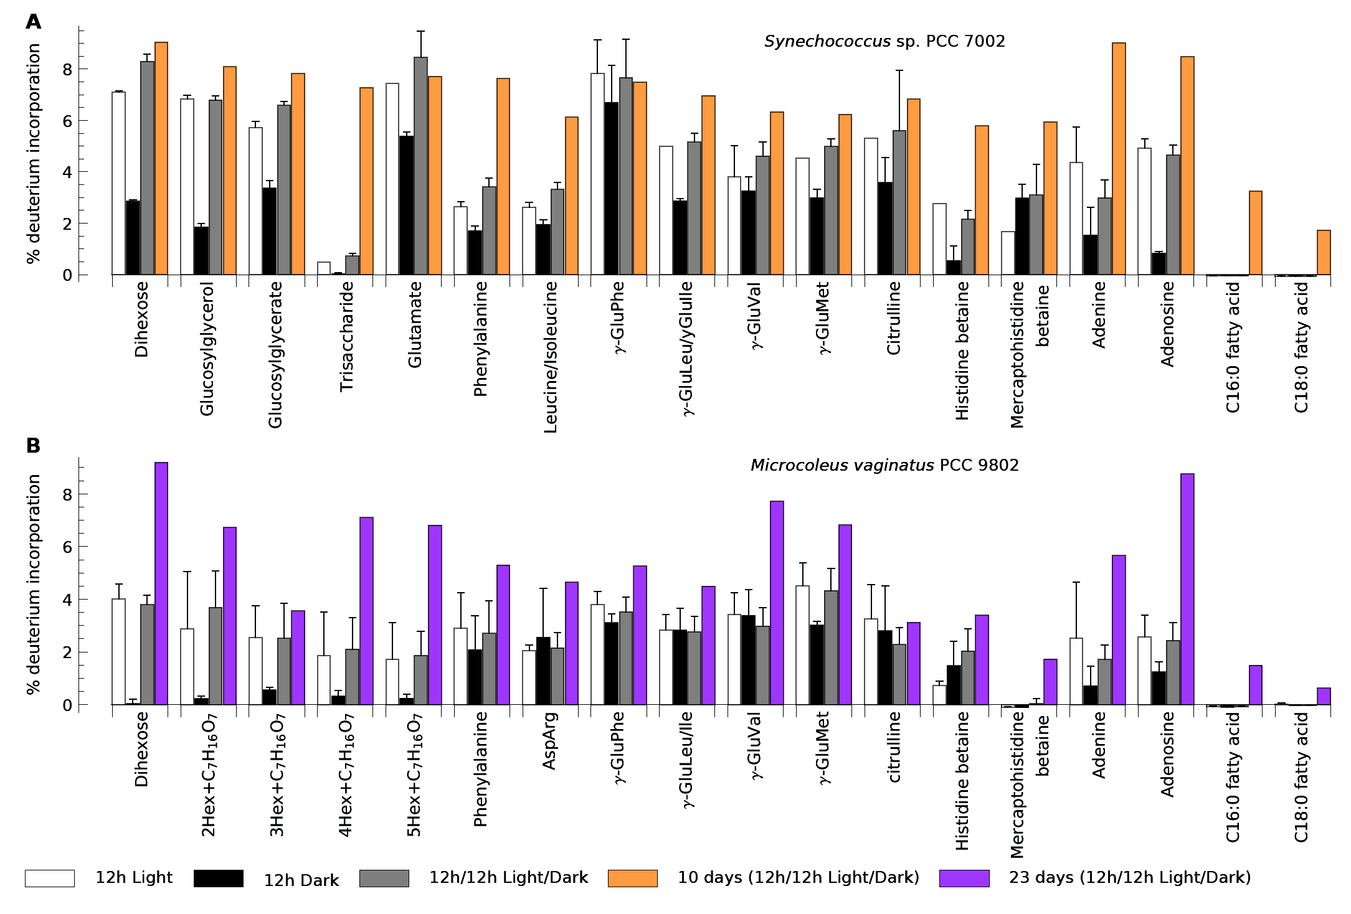
Find that despite slow growth Microcoleus has a high turnover of dihexoses (sucrose)
High flux of glucosyl glycerol
Glycans are made during the day
Amino acids are made night and day
Fatty acids are recycled?

Slide 11
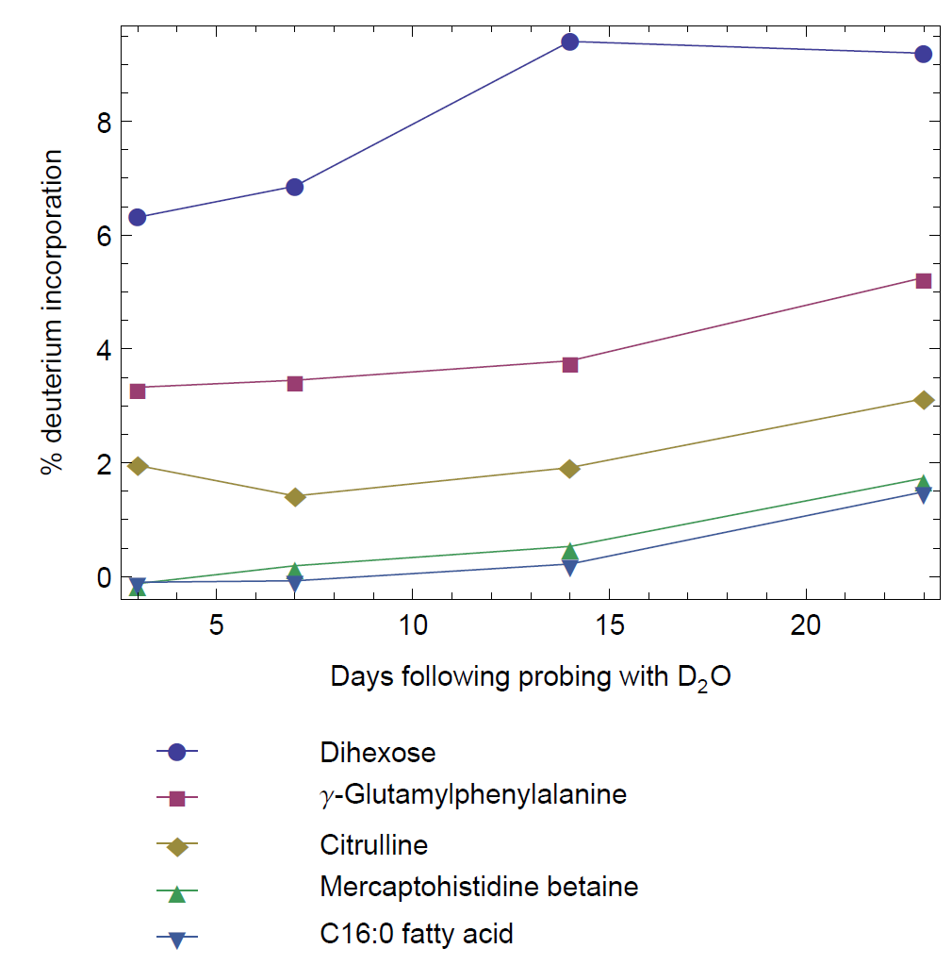
Compatible solutes have the highest flux
Dihexose (Mv) and Glucosyl glycerol in Synechococcus >6% @12hrs

Slide 12
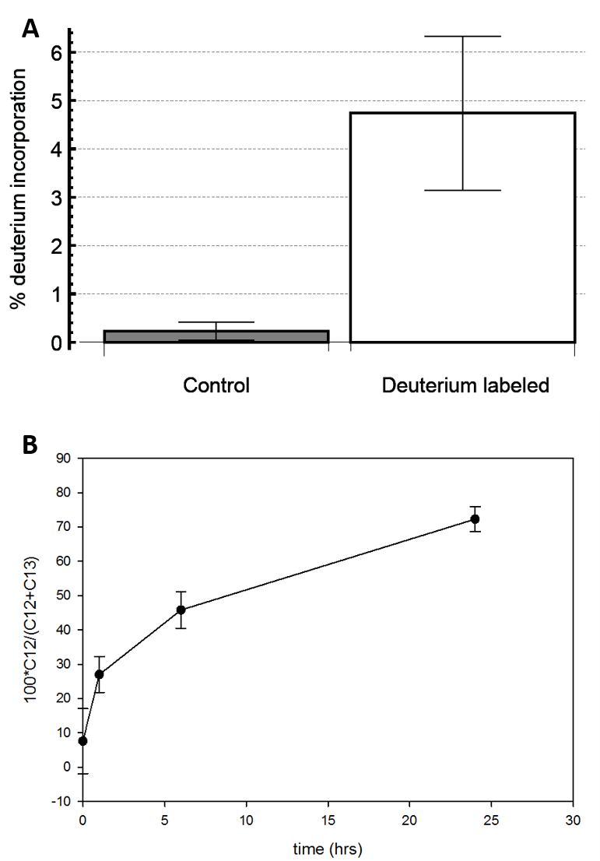

How do you have a high flux through compatible solutes?
The compatible solutes must be going somewhere?
High flux to glycogen
Compatible solutes Biopolymers?

Slide 13
Testing hypothesized conversion of glycosyl glycerol to glycogen
YES-- increasing incorporation of ¹²C glucose into glycogen
+¹²C glucosyl glycerol T0-T25min
¹³C labeled Cyanobacteria
Hydrolyzed glycogen and measured ¹²C incorporation
Compatible solutes Biopolymers

Slide 14
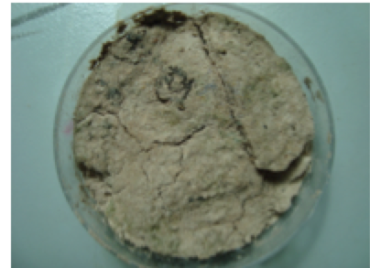
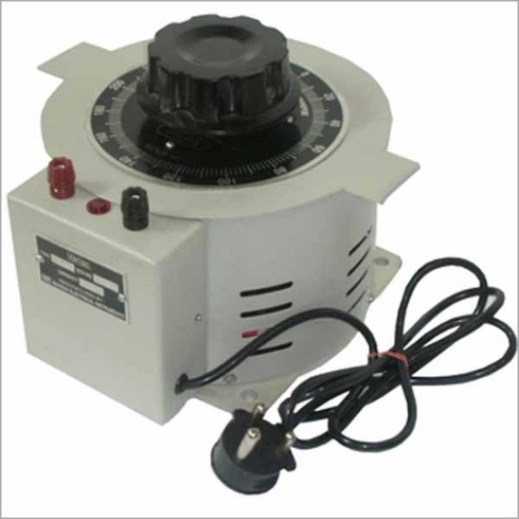

Maintaining a high compatible solute flux enables rapid adjustment of intracellular osmotic potential
Compatible solutes Biopolymers
Based on this we added biopolymer biosynthesis reactions into our flux balance model

Slide 15
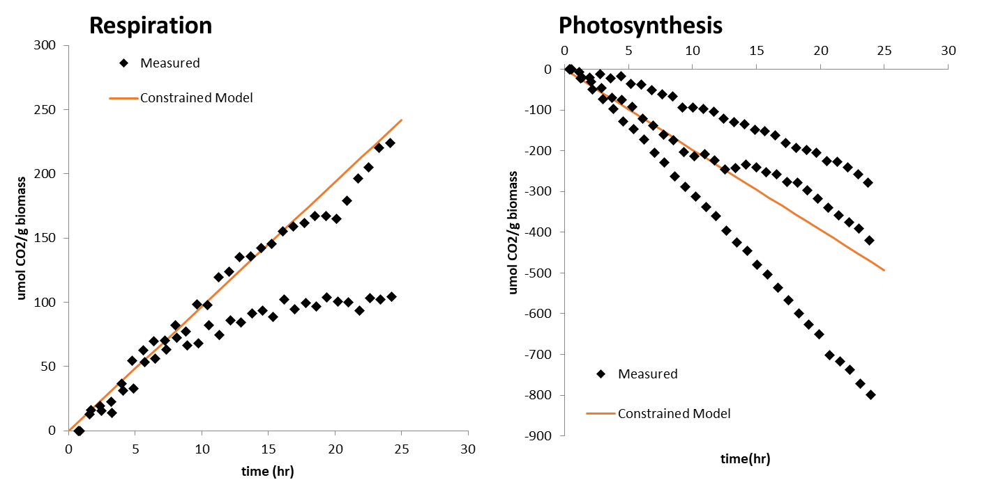
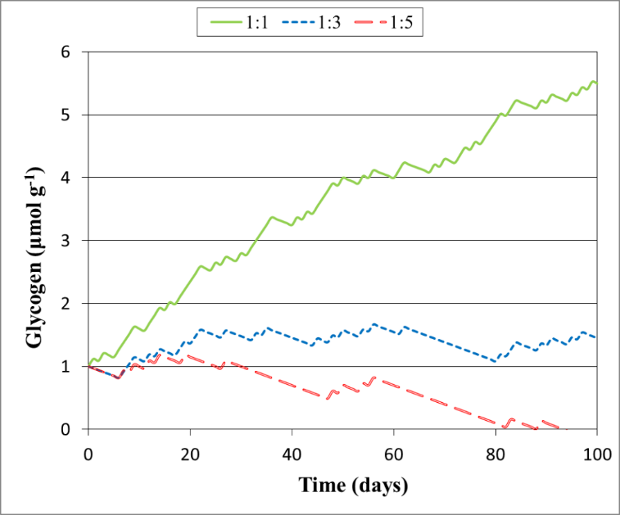
Good fit to experimental data when we constrain model the model using measured biopolymer accumulation in the light and dark
Light:Dark periods
Build biopolymer pool
Deplet biopolymer pool
Jose et al, in Review
Notes:
Could be a weak link

Slide 16

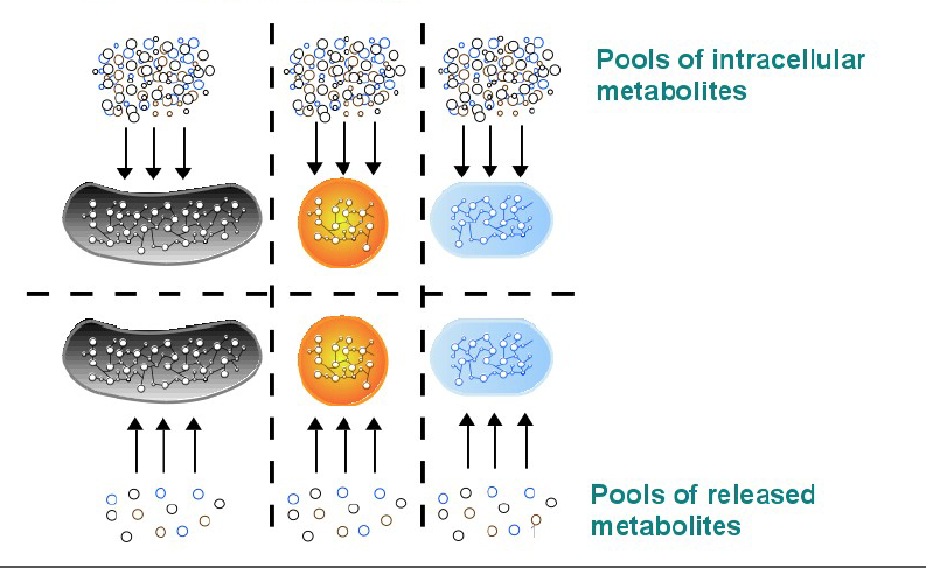
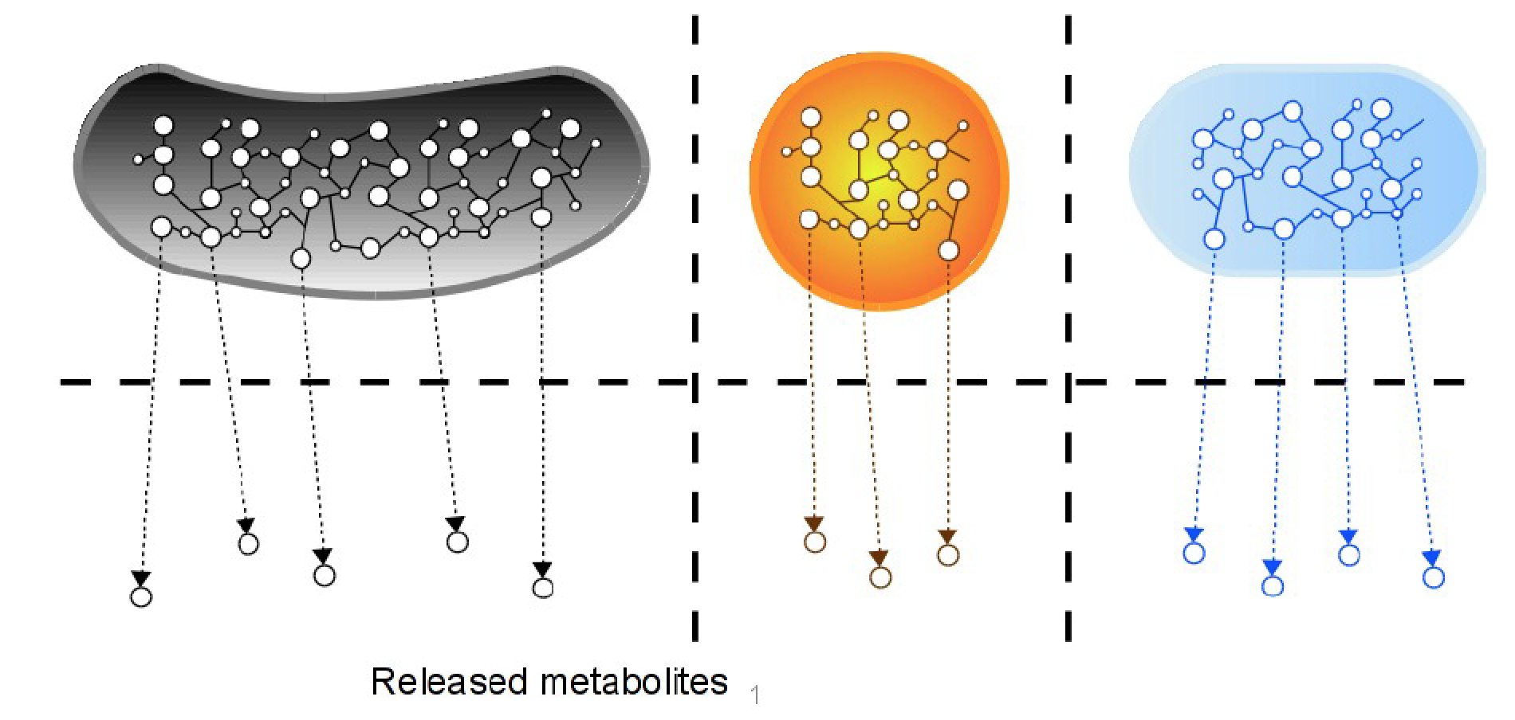
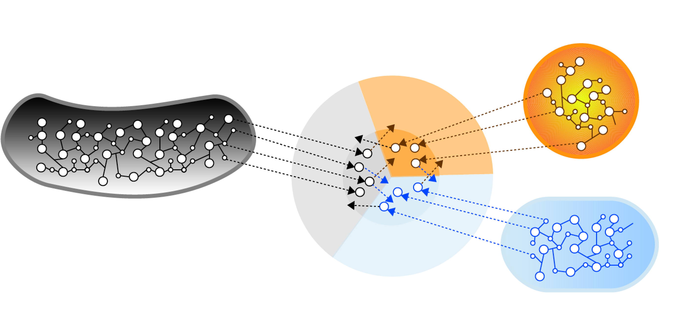
Examination of metabolite exchange in the cyanosphere using exometabolomics
Measure released metabolites in minimal media
Measure metabolite uptake from complex media
Predictions of crossfeeding & resource competition

Slide 17
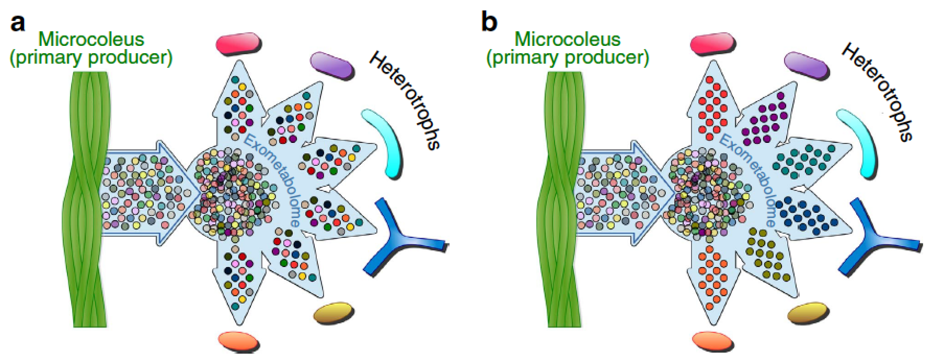
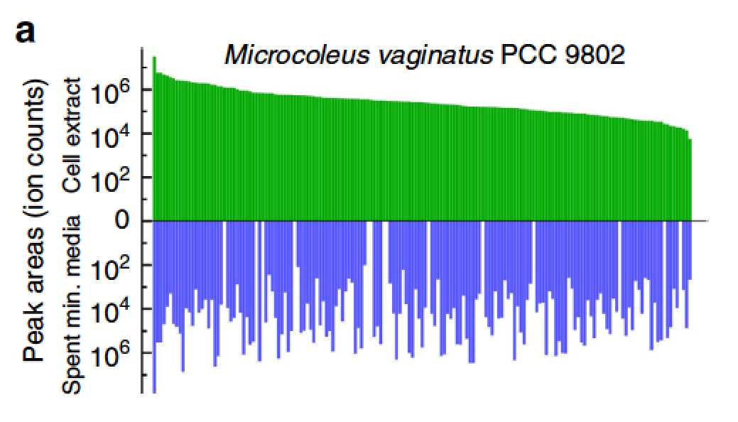
Microcoleus releases a large fraction of it’s ‘metabolome’
endometabolome
exometabolome

Slide 18
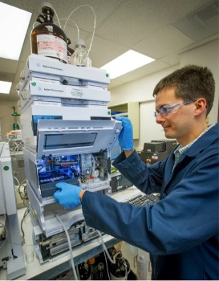
Biocrust exometabolite webs of microbes
Richard Baran
They all eat everything:
Metabolites do not support diversity
They target specific metabolites:
Exometabolite niche partitioning
Baran et al Nature Communications 2015 DOI:10.1038/ncomms9289

Slide 19
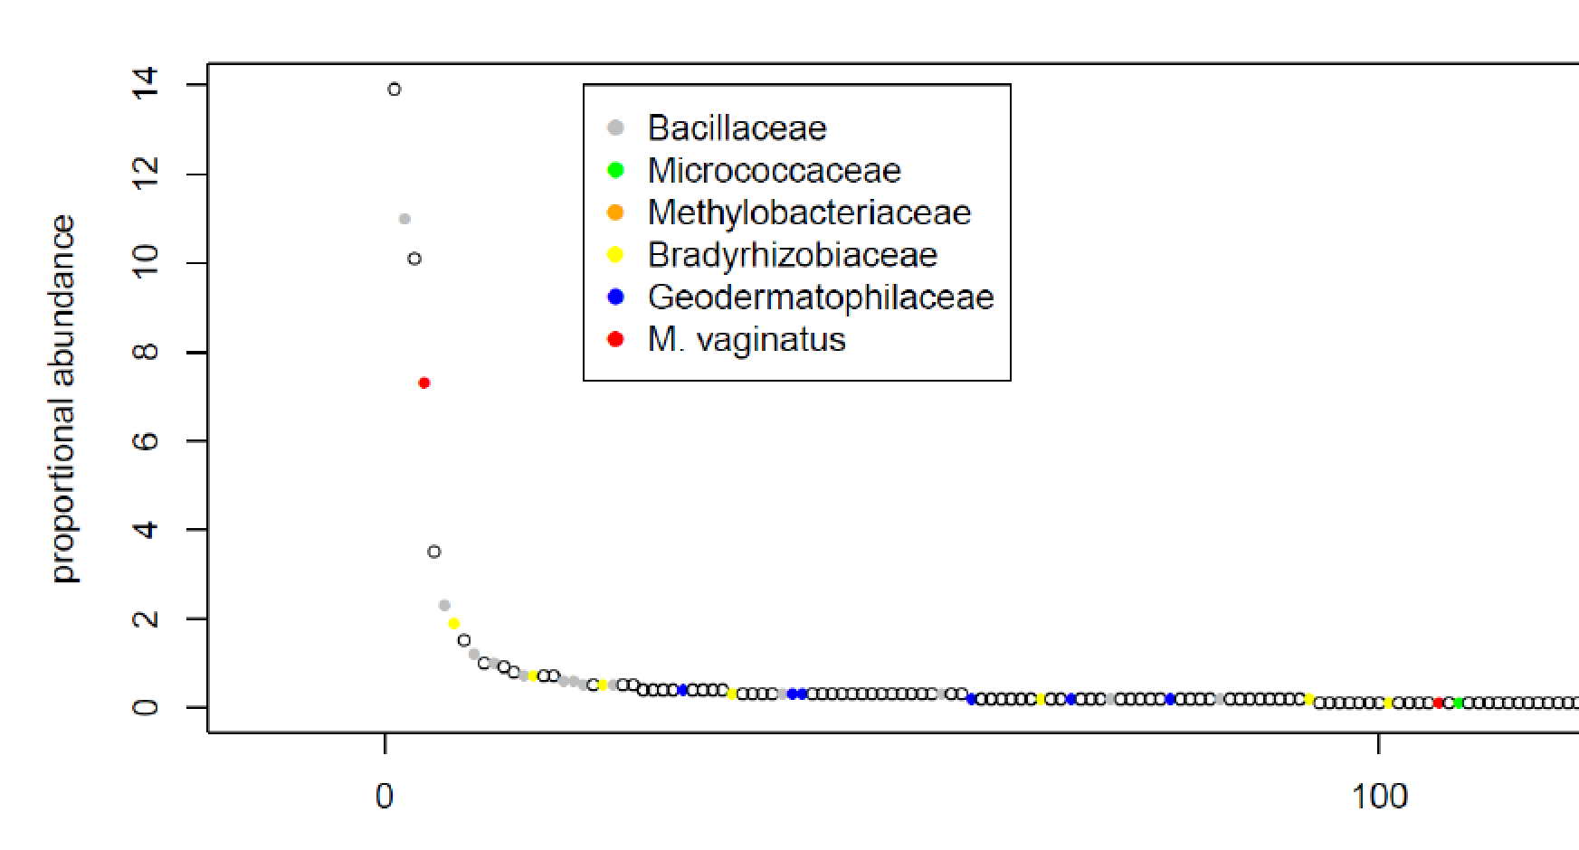
Made isolates to investigate utilization by cyanosphere heterotrophs
Da Rocha et al Frontiers in Microbiology (2015)

Slide 20

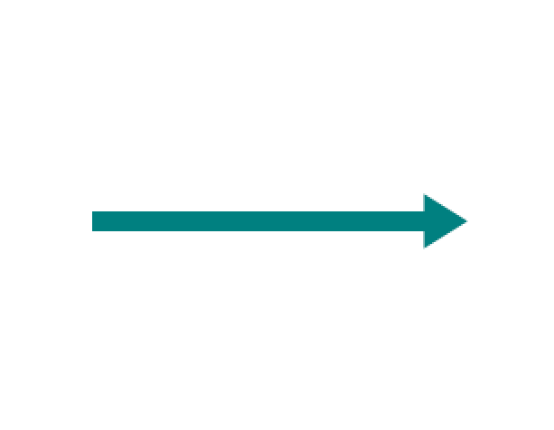

Experimental Approach: Exometabolomics to determine isolate metabolite uptake
Use LC/MS to measure the changes in metabolites
Time 0
T final

Slide 21
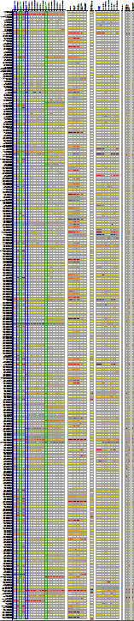
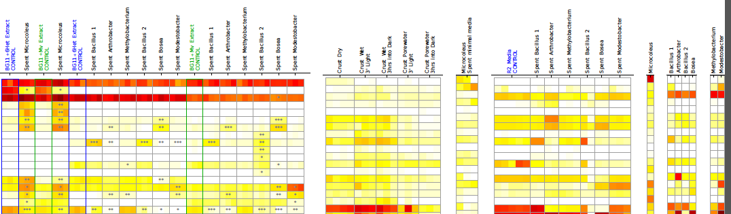
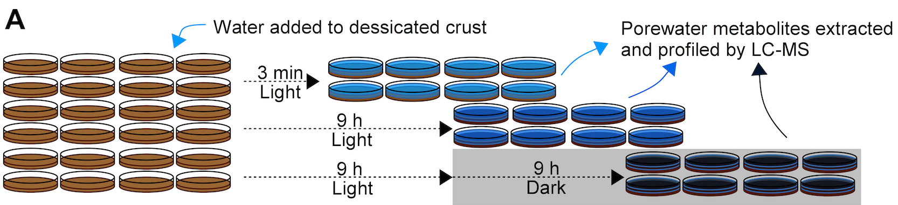
Experiments
Comparison of isolate use of almost 500 unique metabolites
Isolate cell extract
Isolate in minimal media
(Outputs)
Isolate exometabolite analysis on rich media
(Inputs)
Crust extract time series
Metabolites
metabolites
~500 Metabolites with varying degrees of annotation:
Chemical formulas
Partial IDs
Complete IDs

Slide 22
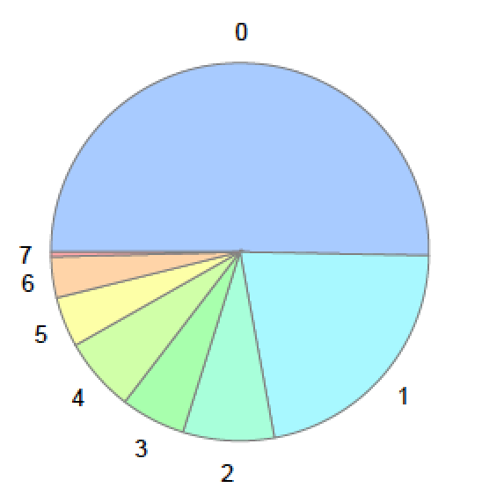
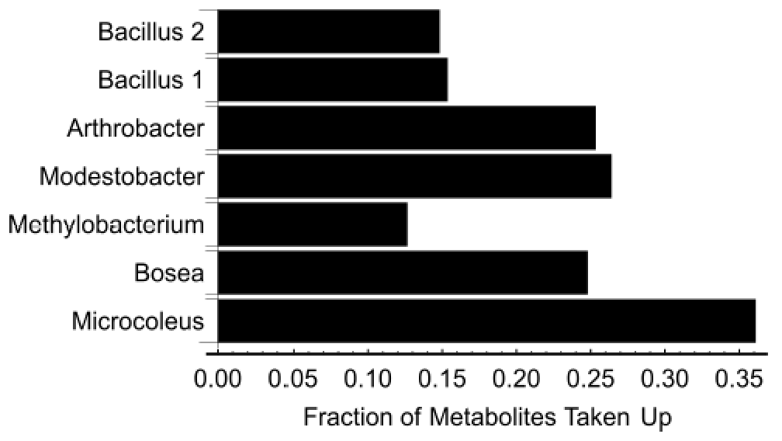
Surprisingly—Isolates show specialization for uptake of specific metabolites
Decreasing diversity should increase soil carbon
Baran et al Nature Communications 2015 DOI:10.1038/ncomms9289

Slide 23
This suggests that we can classify biocrust microbes based on their exometabolomes, predict ensemble activities and design microbiomes that accumulate specific metabolites

Slide 24
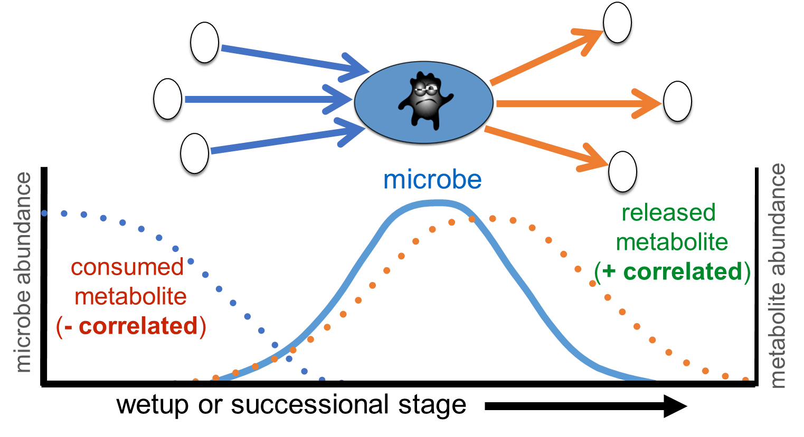
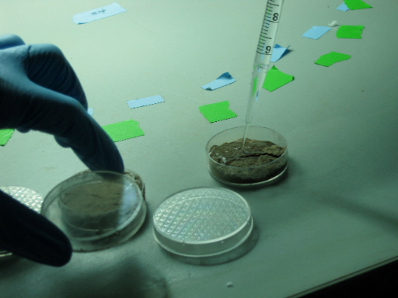
Can exometabolite profiles link microbe and metabolite abundance in situ?
Laboratory Wetting Event

Slide 25
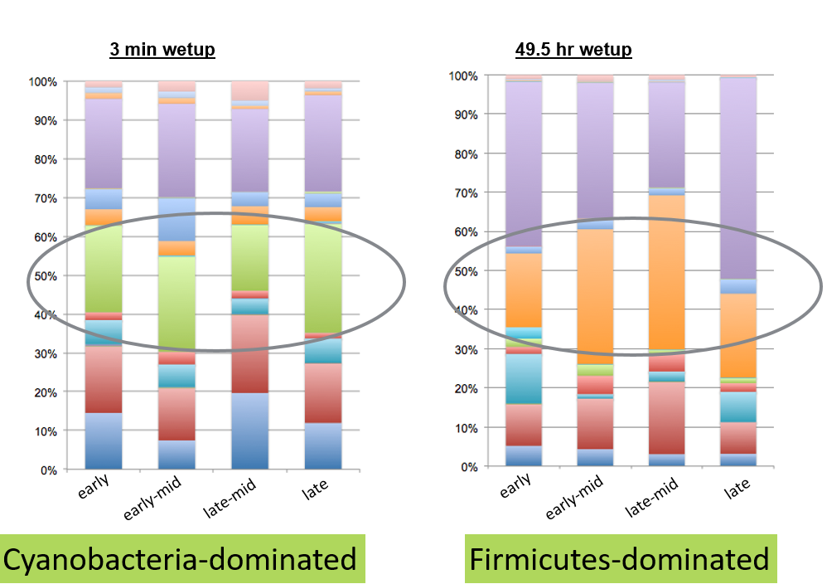



Very fortunate to have isolated close phylotypes of dominate biocrust microbes
Phyla
Increase in Firmicutes during wet-up
Exometabolomics niche partitioning results
Time
Microcoleus- early responder
Bacillus 1- mid responder
Bacillus 2- late responder
Karaoz et al mBio (in press)

Slide 26



Metabolite cycling observed across wetup and successional
purine
carbohydrate
fatty acid
vitamin
peptide
nucleobase
other
amino acid
organic acid

Slide 27








Exometabolomic profiles link dominant bacterial abundance to soil metabolites
Tami Swenson
late-mid successional stage
Microcoleus
Bacillus 1
Bacillus 2
normalized RPKM
1
2
3
4
5
wetup time
wetup timepoint
Swenson et al Nature Communications 2017
Notes:
Now analyzing metagenome and metatranscriptomes for functional information

Slide 28






Webofmicrobes.org
Built a web repository of exometabolomics data as a community resource for designing microbiomes
Suzie Kosina
Annette Greiner (NERSC)
Cyanobacteria
N-fixing heterotroph

Slide 29
Summary
Introduce metabolomics approaches
Introduction to biocrusts
Flux Balance Analysis modeling of cyanobacterial metabolism
Stable isotope probing to identify unexpected metabolic processes
Extension to cyanosphere microbiomes

Slide 30




Acknowledgements
LBNL/JGI/JBEI
Richard Baran
Tami Swenson
Ben Bowen
Eoin Brodie
Ulisses Nunes da Rocha
Ulas Karaoz
ASU
Ferran Garcia-Pichel
Garcia-Pichel Lab
Northenlab.org
@northenlab
DOE Office of Biological and Environmental Research Genomic Sciences Program:
  ECRP Award
  Joint Genome Institute
LBNL LDRD Support

